Slide 1
Super and a house
Making housing attainable
Department of Personnel Management
Paul Sayer, CEO
Oct 2023

Slide 2
Facilitating housing in PNG
Superannuation
Employer Contribution
Employee Contributions
Voluntary
Contributions
8.4%
6%
?
The primary objective of Superannuation is to create wealth for members to enjoy a reasonable standard of living after retirement.

Slide 3
Facilitating housing in PNG
Superannuation
Employer Contribution
Employee Contributions
Voluntary
Contributions
Housing Advance dips into retirement savings to attempt to making housing more attainable.
8.4%
6%
?
The primary objective of Superannuation is to create wealth for members to enjoy a reasonable standard of living after retirement.

Slide 4
Facilitating housing for PNG
Superannuation
New Legislation
Employer Contribution
Employee Contributions
Voluntary
Contributions
Housing Contribution
Medical Insurance Contributions
Death and Permanent Disability
Insurance
Contributions
8.4%
6%
?
The primary objective of Superannuation is to create wealth for members to enjoy a reasonable standard of living after retirement.
Create new buckets to enable workers to save for the purpose of housing and ancillary benefits in addition to super.

Slide 5
First Home Savers Fund
FHSS Employer Contribution
Investment Income
Fixed Interest
Property Investment Income
State Fixed Interest
Short Term TB Bills
Long Term GIS
Rental Income
Sale of Developed Properties
The primary objective of FHSS is to Support Property Purchase and Develop Property for residential uses State Securities for Fixed Interest Support and Liquidity with concessional taxation treatment.

Slide 6
Facilitating housing for PNG
Ideal investments would be Short Term Government Bills and Bonds and we would push for lower tax on investment earnings on these compared to Super. This could lower Government borrowings expenses.
Administration may be easier to be managed by Super Funds as a separate Account and allows the management of transition to rules from existing Housing Advance Rules
Transition ultimately would stop any new funds from leaving Super for a house i.e. What you have available now remains and new funds come from the First Housing Savings Scheme.

Slide 7
Facilitating housing for PNG
Transition to funding the various buckets over a defined period of time e.g. five years
A portion of future Salary Increases are diverted to the buckets until such time as the set level is obtained
This allows some salary increases each year and funding say for the Housing Bucket
Include the investment income earned on the Bucket to be used as part of the deposit
Potential for additional Employee After tax to be redirected here.
First House Savings Bucket Funds not needed to be repaid like they are from the Housing Advance from the Super fund.

Slide 8
Facilitating housing for PNG
Seek concessional treatment of the Bucket Investment Income Taxation
The investment needs to be in short term investments so slightly different to normal super funds as they can be drawn at quick notice
Bucket only used for Housing if not used then can be paid out to the individual like an Employer Additional Account in Superannuation and taxed the same rates as Employer Account is when employment ceases (generally concessional based on service)
Suggested Government has made savings on some components such as leave entitlements and will have lower costs based on lower salary bill so can offset by granting tax benefits on the bucket

Slide 9
Transition Arrangements
Year | Potential Salary Increase | Actual Pay Rise | First Home Scheme | First Home Scheme Total Cumulative Amount | Accumulated Deposit (+i)
1 | 4% | 2% | 2% | 2% | 2%
2 | 4% | 2% | 2% | 4% | 6%
3 | 4% | 2% | 2% | 6% | 12%
4 | 4% | 2% | 2% | 8% | 20%
5 | 4% | 2% | 2% | 10% | 30%
6 | 4% | 4% | 0% | 10% | 40%
7 | 4% | 4% | 0% | 10% | 50%

Slide 10
After 5 years new Starters to work force First Home
Year | Potential Pay Rise | Actual Pay Rise | First Home Scheme | First Home Scheme Total Cumulative Amount | Accumulated Deposit (+i)
1 | 4% | 4% | 0% | 10% | 10%
2 | 4% | 4% | 0% | 10% | 20%
3 | 4% | 4% | 0% | 10% | 30%
4 | 4% | 4% | 0% | 10% | 40%
5 | 4% | 4% | 0% | 10% | 50%

Slide 11
Loan Term
Loan term | Interest Rate | Repayment Percent of Salary | Loan Multiple times Salary | Deposit | Maximum Purchase Price for House |  | Loan term | Interest Rate | Repayment Percent of Salary | Loan Multiple times Salary | Deposit | Maximum Purchase Price for House
30 | 5.50% | 35% | 5.09 | 0.565 | 5.652 |  | 30 | 4.50% | 35% | 5.70 | 0.6335 | 6.335
25 | 5.50% | 35% | 4.69 | 0.521 | 5.217 |  | 25 | 4.50% | 35% | 5.19 | 0.5767 | 5.767
20 | 5.50% | 35% | 4.18 | 0.464 | 4.647 |  | 20 | 4.50% | 35% | 4.55 | 0.5059 | 5.059
15 | 5.50% | 35% | 3.51 | 0.390 | 3.904 |  | 15 | 4.50% | 35% | 3.76 | 0.4176 | 4.176
10 | 5.50% | 35% | 2.64 | 0.293 | 2.931 |  | 10 | 4.50% | 35% | 2.77 | 0.3077 | 3.077
5 | 5.50% | 35% | 1.49 | 0.166 | 1.661 |  | 5 | 4.50% | 35% | 1.54 | 0.1707 | 1.707
0 | 5.50% | 35% | 0.00 | 0 | - |  | 0 | 4.50% | 35% | 0.00 | 0.0000

Slide 12
Loan Term
Loan term | Interest Rate | Repayment Percent of Salary | Loan Multiple times Salary | Deposit | Maximum Purchase Price for House |  | Loan term | Interest Rate | Repayment Percent of Salary | Loan Multiple times Salary | Deposit
30 | 5.50% | 30% | 4.36 | 0.484 | 4.845 |  | 30 | 4.50% | 30% | 4.89 | 0.543
25 | 5.50% | 30% | 4.02 | 0.447 | 4.471 |  | 25 | 4.50% | 30% | 4.45 | 0.494
20 | 5.50% | 30% | 3.59 | 0.398 | 3.983 |  | 20 | 4.50% | 30% | 3.90 | 0.434
15 | 5.50% | 30% | 3.01 | 0.335 | 3.346 |  | 15 | 4.50% | 30% | 3.22 | 0.358
10 | 5.50% | 30% | 2.26 | 0.251 | 2.513 |  | 10 | 4.50% | 30% | 2.37 | 0.264
5 | 5.50% | 30% | 1.28 | 0.142 | 1.423 |  | 5 | 4.50% | 30% | 1.32 | 0.146
0 | 5.50% | 30% | 0.00 | - | - |  | 0 | 4.50% | 30% | 0.00 | 0.000

Slide 13
Purchase Land to build
Price of Purchasing is determined from 2 components
Developing the LAND Building a HOUSE
Cost to purchase Land from owners
Costs to Service:
  Power Electricity
  Roads
  Water
  Sewage
Materials
+
Labour
+
Taxes

Slide 14
Buying the HOUSE + LAND
EQUITY / MONEY SAVED LOAN
Savings
Superannuation or
other Savings
Cost of Capital
  Credit Default
  Cost to Operate the Business
Borrowing Costs
  Saving
  Share Holders

Slide 15
Impact to an Individual for Borrowing
Loan Amount is determined based on Taxable Salary.
Repayments is maximum Percentage of Taxable Income, i.e. Salary + Taxable Allowance e.g. 30% maximum.
Loan term is determined – Years to a defined Age say 65:
  35 year old = 30 years
  40 year old = 25 years
  Younger can borrow longer than older
Interest Rate – Lower Interest Rates means more can be Borrowed.
Maximum Loan Amount is limited to multiples of Equity, e.g. 4 time or 9 times.

Slide 16
Advocacy areas – TAX, POLICY and PARTNERSHIPS
SOE ownership potential – synergies or potential to lower cost of development infrastructure
Working with Treasury about Tax, Super reforms
Advocacy to reduce, remove GST on housing materials and lower income taxes
Super AND Housing not Super OR Housing
Potential Investment in Developers or support to others
There is no simple way for the Fund to supply housing.
There are many ways we can service our members through continuing to advocate for reforms that will help them achieve housing.
The NSL team are committed to continue to work on Policy Advocacy for the benefit of members.

Slide 17
Advocacy areas - LANDS
Support for Customary Land conversion
Strata Title to allow multi story developments to occur more easily
Allowing Real Estate Investment Trust REITS so as to allow others to create and to allow recycling of Capital
Improvements in the Lands department about ownership and speed to generate Titles
Informal Settlements
Having any Land gifted may be hard to obtain from the State.
The concept of apartments in high rise with legal title to the owners is something that is not typically done in PNG.
Does high density living be consider suitable considering the PNG’s community based culture

Slide 18
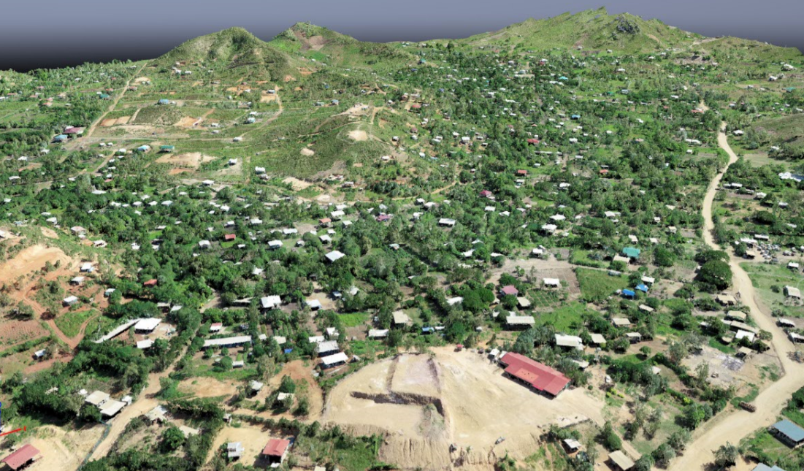
9 Mile
Legal work continues to secure all 4 blocks under NSL title
Exploring how to proceed with development
Need to determine viability based on site issues and strengths
Project initiation has commenced to determine financial feasibility.

Slide 19
What is required to make this happen
Employer and Employees need to agree to the Salary redirection (Accord)
Minor variation to Super Laws to allow Employer Additional Contributions (Salary Sacrifice) to be eligible for Housing Deposits
Transition laws for withdrawal amounts to change over from Housing Advance to First Home Savings Scheme
Taxation Investment Concessions to be agreed
Salary Concessions to be agreed up from 15% to 18.4% (8.4% Super plus 10% for House)

Slide 20
Thank You

