Slide 1
DEPARTMENT OF PERSONNEL MANAGEMENT
REFORMS WORKSHOP
RETIREMENT
Presenter: SHEILA REX
Senior HR Client Service Officer
Southern Region

Slide 2
OUTLINE
Key Policy Directives
Five (5) Year Retirement Strategy
Overview of the Retirement Process
Retirement vs Retrenchment
Retirement Benefits
Marginal Tax
Review of Tax Calculation for Furlough Leave (LSL) by IRC
Way Forward

Slide 3
KEY POLICY DIRECTIVES
NEC Decision 122/2019
NEC Decision 17/2017
Joint Circular August 2016
NEC Decision 304/2016
Circular Instruction 15/2015
Repealed in Section 46B of the Income Tax Act, 1979 gave prominence in the Reduction of Furlough Tax Schedule

Slide 4
RETIREMENT STRATEGY
All compulsory age retirees should be exited from payroll by means of cleansing the government payroll data & reduce payroll over expenditure.
DPM and Dept. of Treasury with Dept. of Finance have commenced this exercise since 2020 proper.

Slide 5
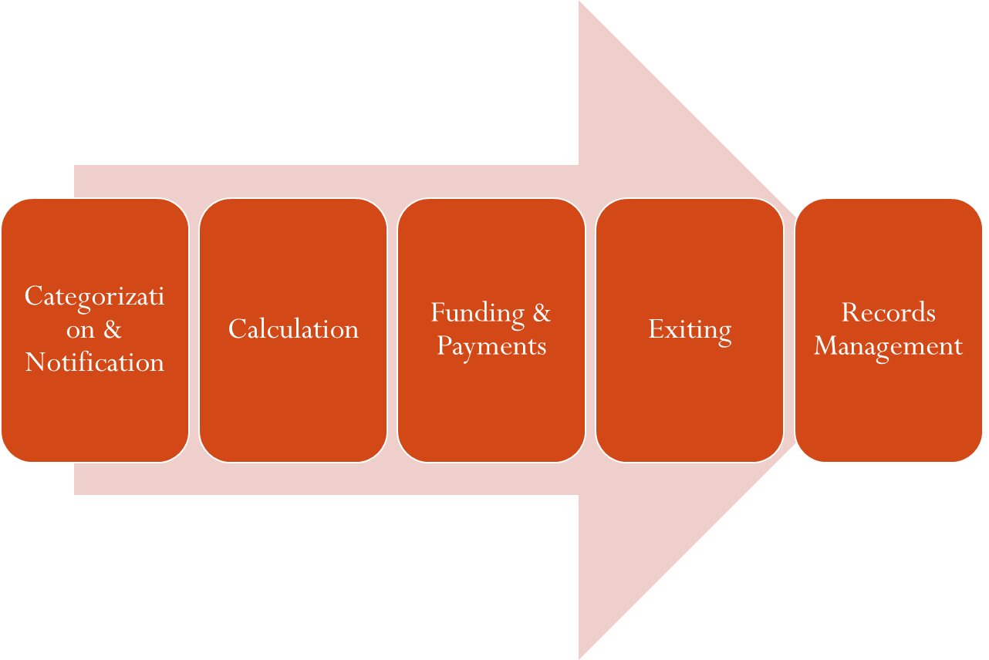
OVERVIEW OF THE RETIREMENT PROCESS

Slide 6
OVERVIEW OF THE RETIREMENT PROCESS
Request on Medical Grounds
Medical Opinion
Consultation
Sick Leave Credits
Calculation
Funding & Payments
Exiting
Records Management

Slide 7
RETIREMENT vs. RETRENCHMENT
RETRENCHMENT
Only to be declared by Secretary DPM
Retrenchment is the termination of services of an officer who has been made redundant in the interest of the State after all avenues to redeploy the officer have been exhausted without success
Retrenchment is applied in a redundancy situation caused by the abolition of functions and activities, administrative re arrangements, Transfer of functions to another agency ,privatization of a government agency, etc (GO16)
Ex-gratia applicable as compensation for cutting lifespan of officers within the Public Service

Slide 8
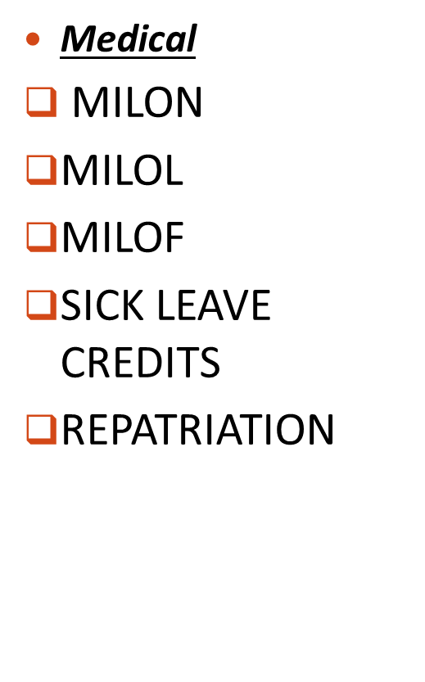
RETIREMENT BENEFITS

Slide 9
Marginal Tax
The current tax application is based on Marginal tax rate as follows:
K0-20,000.00 is 0%
K20,000.01 – K33,000.00 is 30 %
K33,000.01 – K70,000.00 is 35 %
K70,000.01 – K250,000.00 is 40 %
Anything above is 42%

Slide 10
Review of Tax Calculation on Retirement (Furlough Leave/Long service Leave)Payout by IRC
NO. OF YEARS | RATES OF TAX
0 – 3 YEARS | Not Applicable
4 YEARS | Marginal Tax
5 – 8 YEARS | 15%
9 – 14 YEARS | 8 %
15 YEARS OR MORE | 2%

Slide 11
Eg. Furlough Leave Tax Calculation
Agency: Hollywood
Name: Tom Cruz
DOC: 01st Jan, 2019
Grade: 15.5
Annual Salary : K60,854
Fortnight Salary: K2,333.06
Marginal Tax: 4 years of Service
4 years x 9 days
= 36 days /10 working days
= 3.6 Fortnights
3.6 x K2,333.06
=K8,399.02 (Gross)
K8,399.02 x 35%
=K2,939.66 (Tax)
K8,399.02 – K2,939.66
= K5,459.36 (Net)
Agency: Bollywood
Name: Peter Pan
DOC: 01st Jan, 1980
Grade: 15.5
Annual Salary : K60,854
Fortnight Salary: K2,333.06
2 % Tax: 15 years of Service or more
42 years x 9 days
= 387 days /10 working days
= 38.7 Fortnights
38.7 x K2,333.06
=K90,289.42 (Gross)
K90,289.42 x 2%
=K1,805.79 (Tax)
K90,289.42 – K1,805.79
=K88,483.63 (Net)

Slide 12
WAY FORWARD
Conduct Payroll reconciliation (Quarterly)
Records Management
Retirement Calculations to be done on the proper form (Retirement Benefits Calculation Form 4.12)
Issue proper Retirement Notices to the affected officers
Conduct Information Session /Awareness

Slide 13
END OF PRESENTATION
THANK YOU

