Slide 1

Public Service Reforms Regional Workshop
Offline Payments
Notes:
Do your introduction here and introduce your presentation too.

Slide 2
OUTLINE
KEY DRIVERS
DEFINITION OF “OFFLINE PAYMENT”
VETTING CYCLE
SUBMISSION AT DIRECTORATE LEVEL
VETTING TEAM LEVEL 1
REQUIREMENTS FOR OFFLINES
ENDORSED OFFLINES FOR NATIONAL AGENCIES AND HEALTH AUTHORITIES
OFFLINES IN PROGRESS FOR NATIONAL AGENCIES AND HEALTH AUTHORITIES
ISSUES/ CHALLENGES
WAY FORWARD
CONTACT DETAILS
Notes:
Identify the Outlines as listed in the bulletpoints.

Slide 3
KEY POLICY DIRECTIVES
NEC Decision No.53/2011 -
Circular Instruction No. 15/2015
NEC Decision No. 304/2016
DPM/ Treasury Joint Circular of August 2016 – Cost Saving Measures
NEC Decision No. 71/2017 – Cost Saving Measures
NEC Decision No. 109/2019 – Special General Order 11
NEC Decision No. 122/2019 –
Income Tax Act 1079– Section 46B repealed in 2019 giving prominence to Furlough Tax Reduction Schedule
Notes:
These Policy Directives as you know are to do with the cost saving measures which the Govt is concerned with Public Service wage bill, therefore the following Directives were issued…

Slide 4
WHAT IS …“OFFLINE PAYMENTS”
Claims that are not in the defined retro dates.
Notes:
Back dated claims that are not budget for, for that financial year. Once processed, they contributed to the overruns.

Slide 5
TYPES OF OFFLINE PAYMENTS
GENUINE CLAIMS | OTHERS
FINAL ENTITLEMENTS | HIGHER DUTY ALLOWANCES (ACTING CAPACITIES)
DECEASED | PBSS
RESIGNATION | BACK PAYMENTS OF SALARIES
TERMINATION/ DISMISSED | ALLOWANCES (CONTRACT /DMA/ETC)
END OF EMPLOYMENT CONTRACT( Non Renewal)
PSC /COURT ORDER REINSTATEMENTS
5% TOP OF THE SALARY RANGE (PBSS)
Notes:
Can you explain it in your own understanding

Slide 6
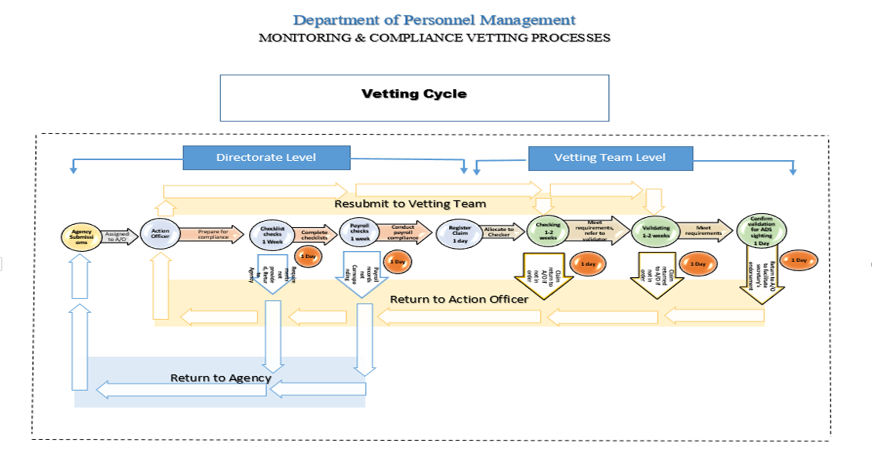

Slide 7
Directorate level
Director
Agency submission –
Register Claim –
Manager M&C
Register claim
Sort nature of claim
Assign to action officer
Action officer M&C
Register
Prepare for compliance –
requirements met – continue/ requirements not met – return to agency ( Refer compliance checklist)
compile & submit to m&c Manager for confirmation on requirements/calculations Checked
submit for vetting – requirements met

Slide 8
Vetting team level - 1
Checker (1-2 weeks)
Register
Allocate claims to respective checker(s)
Checking process - requirements
Proceed for validation - Meeting requirements
Requirements not Met – return to a/ officer
-resubmission is to the checker
6. Accountability of checker ends on return of submission to action officer (date)
Validator (1-2 weeks)
Proceed for validation –
Final checking for Meeting requirements
Proceed with validation - requirements Met
Confirm validation for deputy secretary’s sighting
Requirements not Met – return to a/ officer & manager for appropriate action(s)
-resubmission is to the validator
6. Accountability of validator ends on return of submission to action officer (date)

Slide 9
Requirements for offlines
Agency endorsed letter
Batch control form
Special offline payment & recovery form
Calculation sheet signed off by salary clerk and personnel officer
Approved Resignation letter from d/ head
Death certificate
Copies of Court & PSC Decisions – Reinstatements
Copies of updated salary history cards (all parts)
Staff performance appraisal forms (5%, TOR)

Slide 10
ISSUES/ CHALLENGES
Downtime of Ascender in December, 2021 to June 2022 - led to back-log/ delay in processing of claims
Non compliance to Offline requirements- No updated salary history cards attached, no death certificates attached for deceased cases, etc
DPM turnaround time
Termination bookings on Ascender do not correspond to the actual close of business dates (example, officer resigned on 1 January 2023 but is terminated from Ascender on 23 June 2023, ignoring DOPAY period)
Deceased, resigned, or terminated officers MUST be SUSPENDED OFF from the payroll before final entitlement claims can be processed.
DOPAY – AGENCIES DO NOT RECOUP OVERPAYMENTS (i.e. Officers put off payroll after close of business are not recovered)

Slide 11
WAY FORWARD
ALL OFFLINE CLAIMS CHECKED, APPROVED BY SECRETARY DPM SHOULD BE PROCESSED BY DPM AND NOT DEPARTMENT OF FINANCE ITD
CEASE ALL NON GENUINE OFFLINE CLAIMS
AGENCIES TO CEASE GOING DIRECT TO FINANCE TO PROCESS OFFLINE CLAIMS
TERMINATION CALCULATOR FOR OFFLINE CLAIMS (VERSION UPGRADE)
Notes:
Because DoF holding back claims and recalculating, or referring them back to DPM where Secretary DPM have approved and authorise for payments.

Slide 12
CONTACT DETAILS
Monitoring & Compliance NGI Branch
Telephone Numbers:
327 6310/ 327 6494
EMAIL ADDRESS:
kokivarhymbi@dpm.gov.pg
kkonjib@dpm.gov.pg
mraga@dpm.gov.pg
gkoru@dpm.gov.pg

